Slide 1

INTRODUCTION TO TENSORFLOW
Session -3

Slide 2


Slide 3
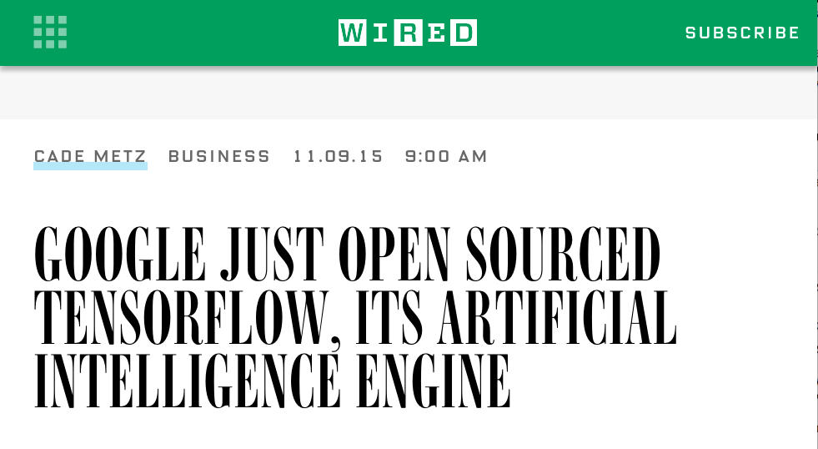
WHAT IS TENSORFLOW?
Notes:
Ignore the WIRED hype: TensorFlow is not an “artificial intelligence engine.”

Slide 4
WHAT IS TENSORFLOW?
From the whitepaper: “TensorFlow is an interface for expressing machine learning algorithms, and an implementation for executing such algorithms.”
In short: TensorFlow is Theano++.
Symbolic ML dataflow framework that compiles to native / GPU code
From personal experience: offers drastic reduction in development time

Slide 5
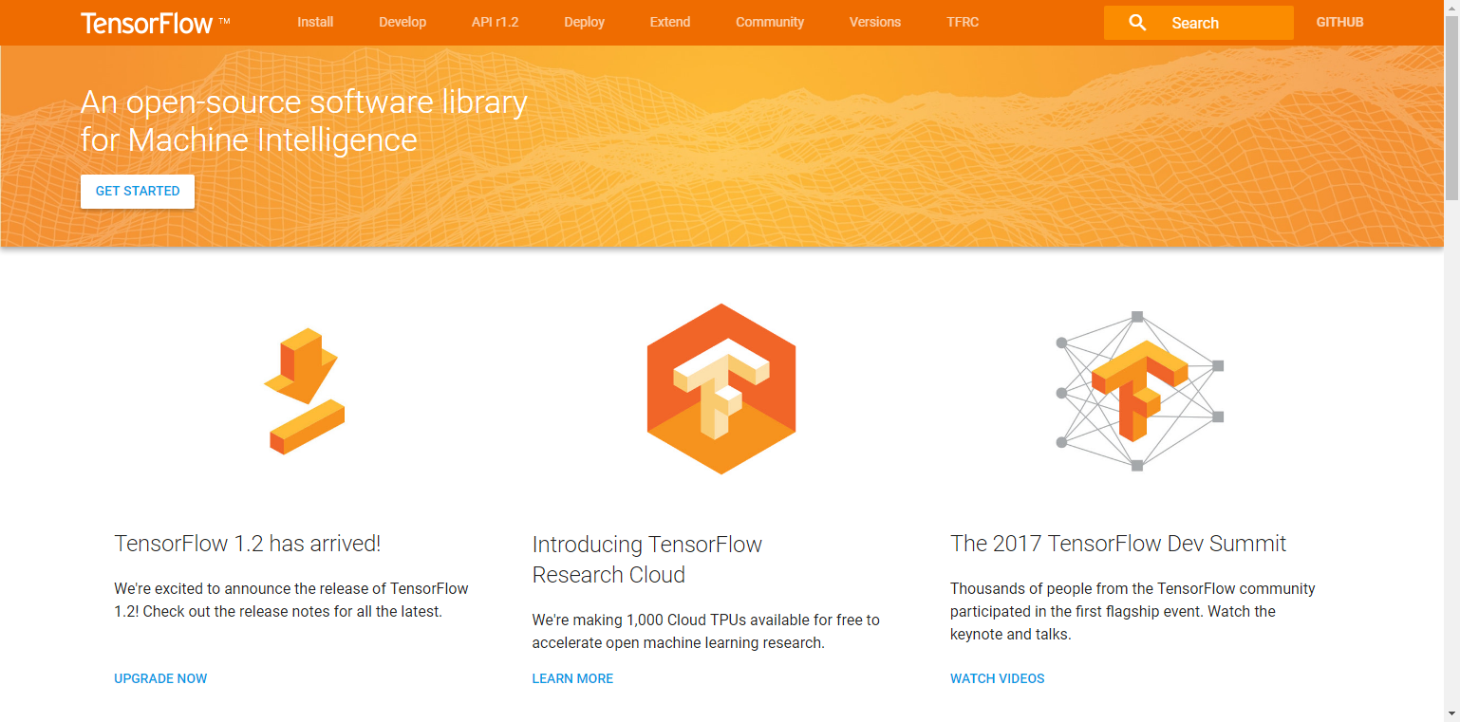
WHAT IS TENSORFLOW?
Open source software library from Google (Brain Team) for machine learning
Especially good for training and implementing deep neural networks
Example applications include image recognition, automated translation. Think Google Photos, Translate
Used in production at Uber, SnapChat, Google (obv.), others
Notes:
Reference:

Slide 6
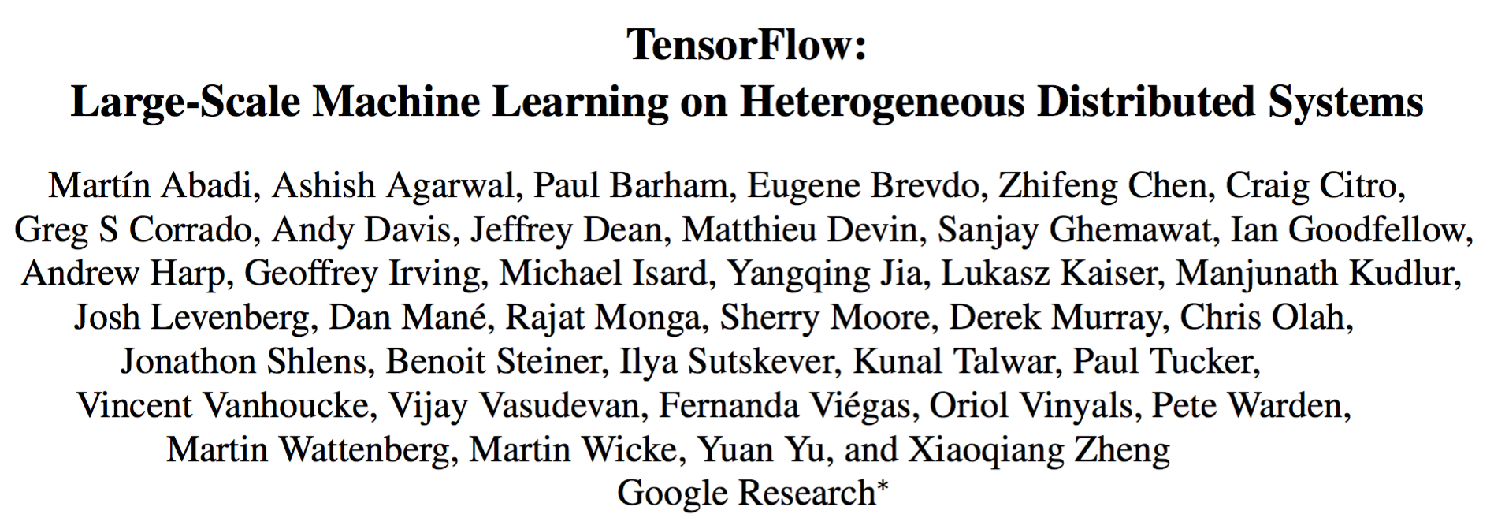
WHO IS TENSORFLOW?

Slide 7
PROGRAMMING MODEL
Big idea: Express a numeric computation as a graph.
Graph nodes are operations which have any number of inputs and outputs
Graph edges are tensors which flow between nodes

Slide 8
How does it work
Uses data flow graphs to represent a learning model
Comprise of nodes and edges
Nodes represent mathematical operations
Edges represent multi-dimensional data arrays (tensors)
“TensorFlow”
C based with Python and C++ APIs

Slide 9
Deep neural networks?
Fancy name for neural networks algorithm with more than one layer
Now possible with cheap HW, huge data sets and better techniques

Slide 10
How Tensorflow different scikit-learn
Scikit-learn - model already built; “off-the-shelf”’; Fit/ predict style
TensorFlow - has to build model up from; should be able to describe your model in the form of a datagraph with functions like gradient descent, add, max, etc.

Slide 11
Examples
https://github.com/aymericdamien/TensorFlow-Examples.git
https://www.tensorflow.org/tutorials/image_recognition
Martin Gorner - https://github.com/martin-gorner/tensorflow-mnist-tutorial
https://youtu.be/qyvlt7kiQoI
https://codelabs.developers.google.com/codelabs/cloud-tensorflow-mnist

